Slide 1
COMPUTER GRAPHICS & MULTIMEDIA
UNIT-2
-by Sakshi Jha

Slide 2
SYLLABUS
Clipping Algorithms: Sutherland-Cohen line Clipping Algorithm,
Bezier Curves,
B-Spline Curves.
Parallel projection,
Perspective Projection,
Illumination Model for diffused Reflection,
Ambient light,
Specular Reflection Model,
Reflection Vector.

Slide 3
CLIPPING ALGORITHM
The primary use of clipping in computer graphics is to remove objects, lines, or line segments that are outside the viewing pane.
The viewing transformation is insensitive to the position of points relative to the viewing volume − especially those points behind the viewer − and it is necessary to remove these points before generating the view.
CLIPPING ALGORITHM
POINT CLIPPING
LINE CLIPPING
POLYGON CLIPPING

Slide 4
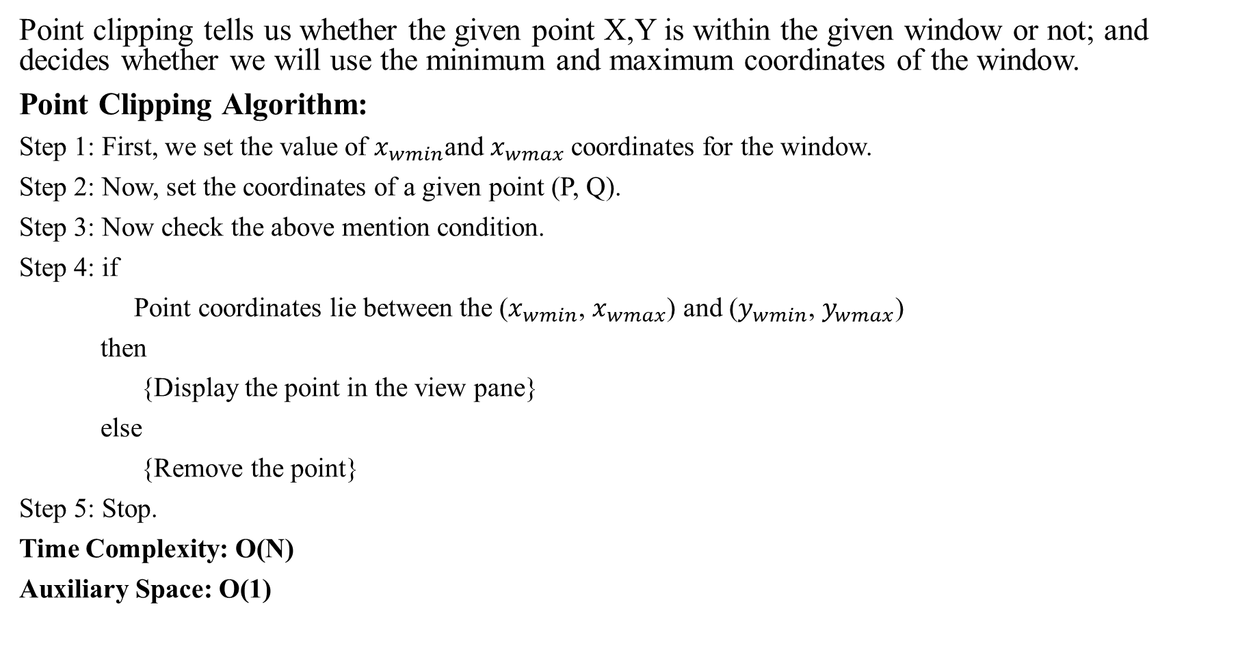
POINT CLIPPING
Point clipping tells us whether the given point X,Y is within the given window or not; and decides whether we will use the minimum and maximum coordinates of the window.
Point Clipping Algorithm:
Step 1: First, we set the value of $x_{wmin}$and $x_{wmax}$coordinates for the window.
Step 2: Now, set the coordinates of a given point (P, Q).
Step 3: Now check the above mention condition.
Step 4: if
Point coordinates lie between the ($x_{wmin}$, $x_{wmax}$) and ($y_{wmin}$, $y_{wmax}$)
then
{Display the point in the view pane}
else
{Remove the point}
Step 5: Stop.
Time Complexity: O(N)
Auxiliary Space: O(1)

Slide 5
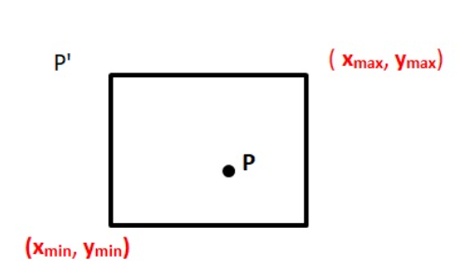
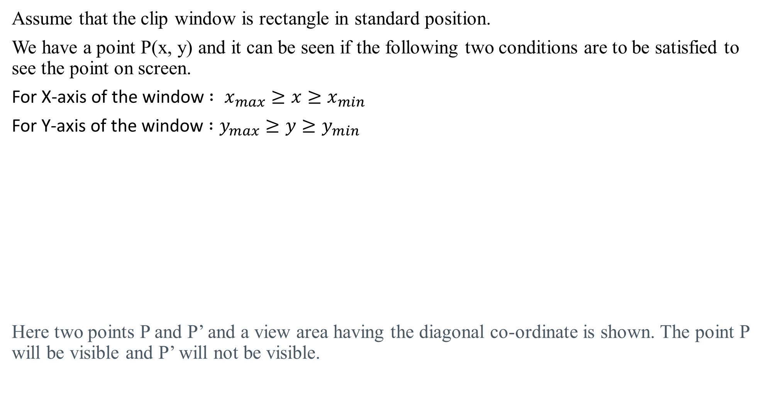
Assume that the clip window is rectangle in standard position.
We have a point P(x, y) and it can be seen if the following two conditions are to be satisfied to see the point on screen.
For X-axis of the window$: x_{max}≥x{≥x}_{min}$
For Y-axis of the window $:y_{max}≥y≥y_{min}$
Here two points P and P’ and a view area having the diagonal co-ordinate is shown. The point P will be visible and P’ will not be visible.

Slide 6
LINE CLIPPING
The line clipping algorithm is used to set the portion of the line to be seen into the define viewport area. But due to the presence of two points (i.e., end points) it is different from point clipping.
To decide whether the line can be viewed or not or whether some portion of the line can be viewed on the viewport, the following steps are followed:
If both the endpoints of a line are outside the viewing area, it can’t be displayed.
And if both the endpoints of a line are inside the viewing area, the complete line will be visible.
If some portions of the line or one or two endpoint is outside the viewing area, the portion of the line is to be displayed.

Slide 7
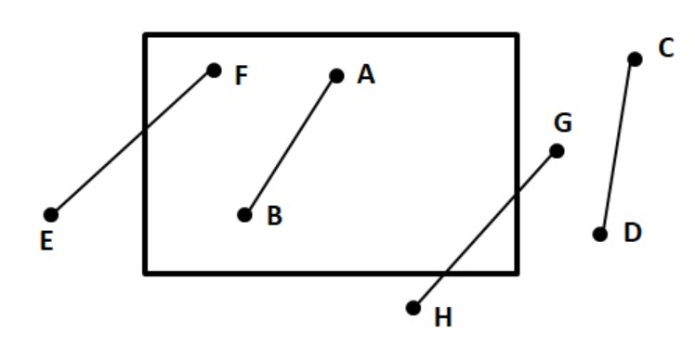
There are four lines shown.
The line AB can be viewed completely as both of its endpoint lies in the viewing area.
Similarly, the line CD cannot be viewed at all as no part of the line lies within the viewing area.
In the same way, the line EF and GH are partially seen in the viewing area as they intersect with the viewing boundary.

Slide 8
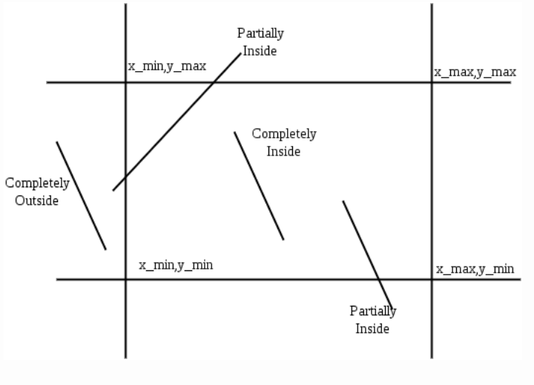
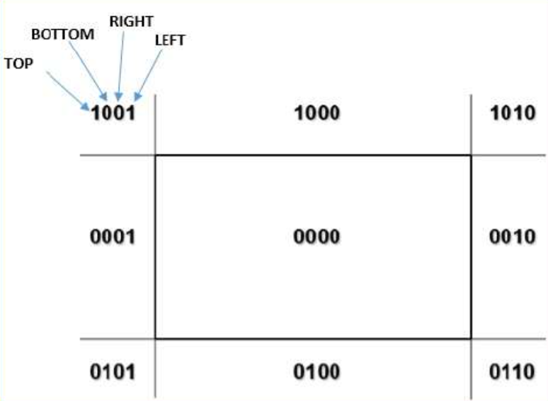
COHEN SUTHERLAND LINE ALGORITHM
The Cohen–Sutherland algorithm can be used only on a rectangular clip window. It divides a two-dimensional space into 9 regions and then efficiently determines the lines and portions of lines that are inside the given rectangular area.

Slide 9
There are three possible cases for any given line:
Completely inside the given rectangle : Bitwise OR of region of two end points of line is 0 (Both points are inside the rectangle)
Completely outside the given rectangle : Both endpoints share at least one outside region which implies that the line does not cross the visible region. (bitwise AND of endpoints != 0).
Partially inside the window : Both endpoints are in different regions. In this case, the algorithm finds one of the two points that is outside the rectangular region. The intersection of the line from outside point and rectangular window becomes new cord ner point and the algorithm repeats.

Slide 10
Algorithm
Step 1 : Assign a region code for two endpoints of given line.
Step 2 : If both endpoints have a region code 0000
then given line is completely inside.
Step 3 : Else, perform the logical AND operation for both region codes.
Step 3.1 : If the result is not 0000, then given line is completely
outside.
Step 3.2 : Else line is partially inside.
Step 3.2.1 : Choose an endpoint of the line
that is outside the given rectangle.
Step 3.2.2 : Find the intersection point of the
rectangular boundary (based on region code).
Step 3.2.3 : Replace endpoint with the intersection point
and update the region code.
Step 3.2.4 : Repeat step 2 until we find a clipped line either
trivially accepted or trivially rejected.
Step 4 : Repeat step 1 for other lines

Slide 11
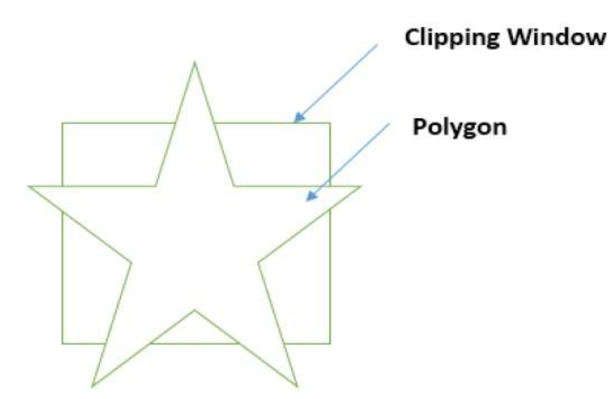
POLYGON CLIPPING
It is also known as Sutherland Hodgman Algorithm.
In this algorithm, all the vertices of the polygon are clipped against each edge of the clipping window.
First the polygon is clipped against the left edge of the polygon window to get new vertices of the polygon. These new vertices are used to clip the polygon against right edge, top edge, bottom edge, of the clipping window as shown in the following figure.

Slide 12
